Slide 1
Eco-Tunisia Mobile App
This work is brought to you by:
- Noussayba Masseoud
- Abir Abdelmoumen
- Asma Ben Fredj
- Nour Jebali

Slide 2
Table of contents
01
02
03
Introduction
Preliminary Study
Design and Implementation
Demo
Conclusion

Slide 3
Introduction
In this project we created a mobile and web application that helps Collection Companies register collection points so people who wish to carry out the disposal can easily locate the disposal sites through the app.

Slide 4
Preliminary Study

Slide 5
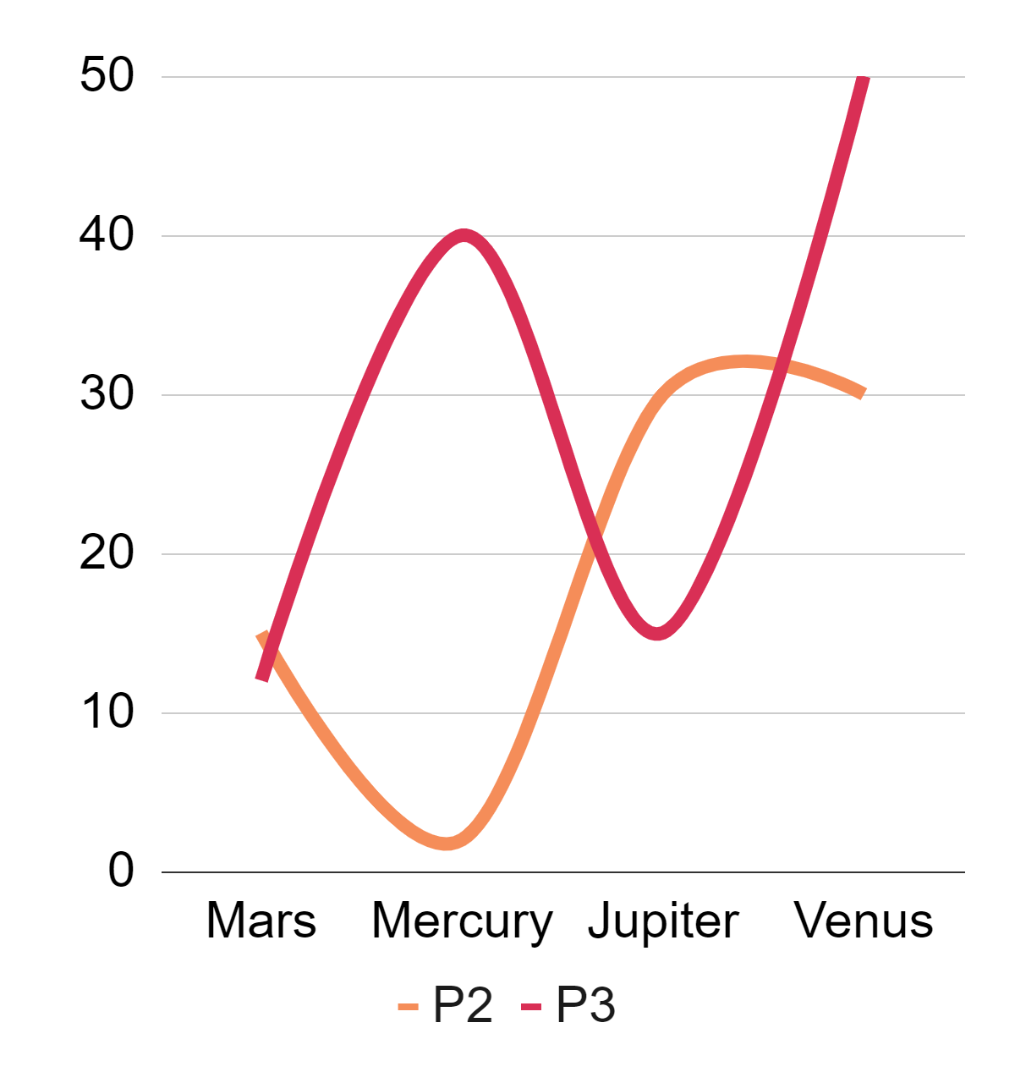
The existing Solutions
In Tunisia, the start-up 2BK Innovation has developed an application to facilitate the collection of municipal waste. The Tunisian start-up recently signed a partnership with the Tunisian Internet Agency (ATI) for the launch of its "Houmati" solution.
Houmati
Site 1
Site 2

Slide 6
Existing Apps Worldwide
WasteConnect
County Waste & Recyc
Dumpsters on Demand
It lets users keep track of their garbage and recycling schedules in a simple format
Users can easily access their normal and holiday collection schedule
It makes it easy for customers of Royal Rolloffs to rent portable assets including dumpsters from the ease of their phone or tablet.

Slide 7
Our Solution
A
B
A collection company register their collection points
The same collection company indicate the type of elements they are recycling
C
D
An ordinary citizen uses the mobile application to find the collection points
They can precise the type of their disposal in order to find the needed collection point

Slide 8
Design and Implementation

Slide 9
Functional Requirements
Precision
Location
In order to match the type of recycling elements of a collection company to the type of disposal of a certain user
The app can locate the collection points on a map

Slide 10
Non Functional Requirements
Maintainability
Performance
The app needs to be functional and reliable.
The application needs to be responding to the user’s needs.
Usability
The app needs to be user-friendly.

Slide 11
Software Requirements
Git
SQLite
Project Management
Database management
Visual Studio
Windows 10
React.Js, TypeScript, React Native, Node Js
Operation System

Slide 12
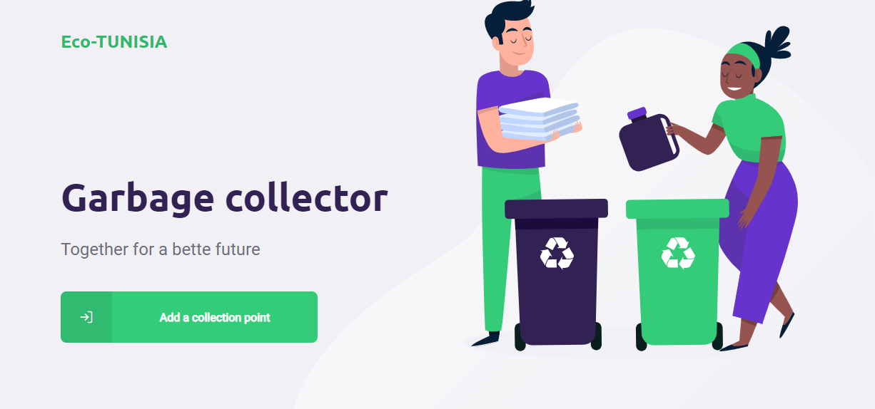
The Proposed Work
Using this web interface, a collection company can add a collection point

Slide 13
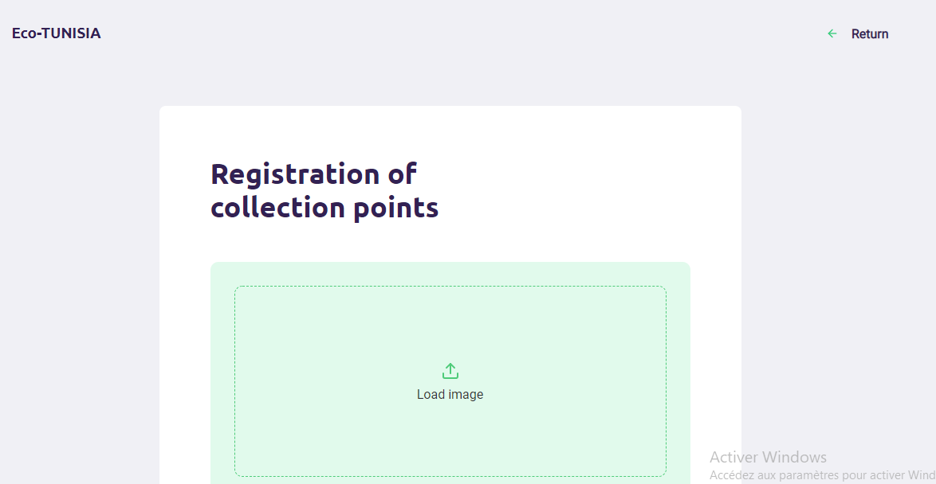
They need to load an image for the collection center

Slide 14
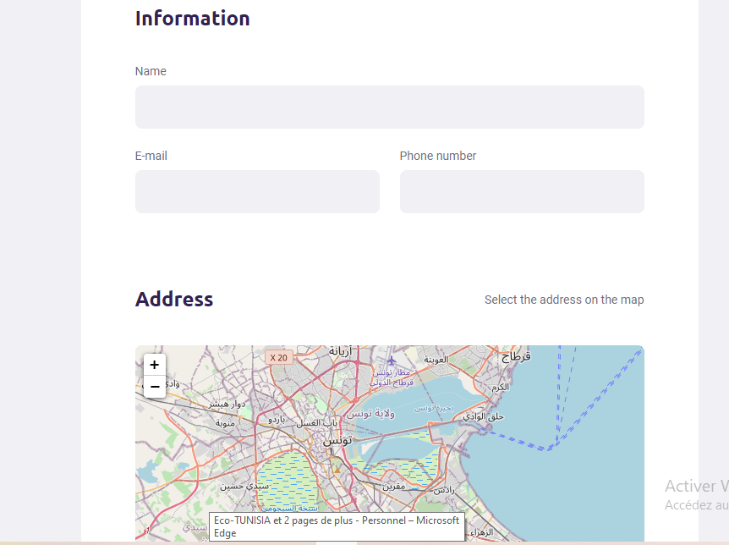
They also need to indicate some information such as the name of the company, their email and phone number

Slide 15
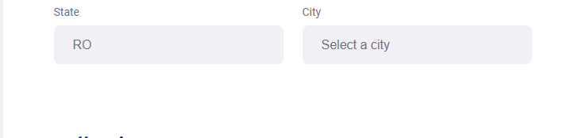
Here they precise their state and city

Slide 16
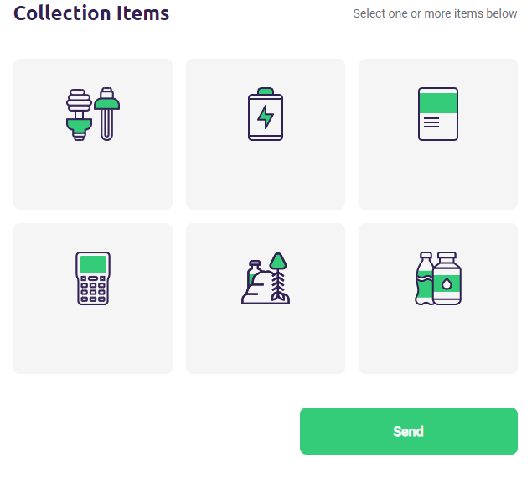
And finally, they indicate the type of elements they are dealing with

Slide 17
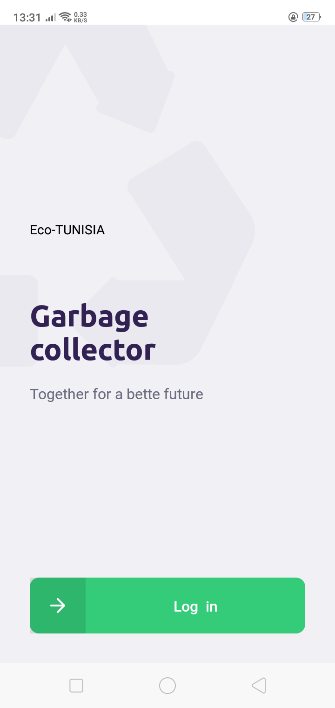
A citizen can now use the mobile application to log in and fin collection points that match the type of their garbage

Slide 18
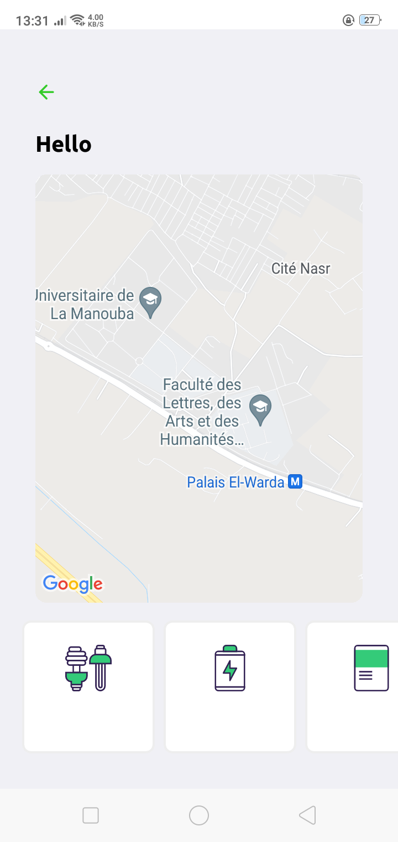
Here, they can see their position on the map along with the position of the collection companies.
The need to precise the type of disposal for an optimal research.

Slide 19
Demo

Slide 20
Conclusion
As you can see, we tried to implement a mobile application that is useful in our daily life and that is eco-friendly.
In terms of perspective, we can think about adding more features that help save the environment.

